Slide 1
Must Learn KQL
The Workshop
<Presenter>
<Title>

Slide 2
Must Learn KQL Module Overview

Slide 3
KQL Module
What this module will cover:
Importance of KQL across Azure
The User Interface (demo)
The standard KQL Structure
Common KQL Commands
Labs
Quizzes
Troubleshooting
What this workshop contains:
Hands-on

Slide 4
Workshop Goals
Read KQL Queries
Write KQL Queries
Notes:
We’ll use hands-on to write KQL queries, but as a tool for learning the structure and ultimately understanding how KQL queries work. The importance of this course is to learn how to READ the queries. i.e., to understand, line-by-line what each query will do and what the results of running the query will be. Being able to understand what results the query will return is most important for level 100-200 knowledge.

Slide 5
KQL Origins

Slide 6
What is KQL?
What does the acronym KQL stand for?
Kusto Query Language
Built for Performance
Read-only (whew!)
Importance:
Log Analytics
Azure Monitor
Azure Security services
Across all of Azure
It’s the language used to query the Azure log databases: Azure Monitor Logs, Azure Monitor Application Insights and others.

Slide 7

Kusto???
Kusto was the original codename for the Azure Application Insights platform that Azure Monitor is now based on and…
YES is named after the famous explorer.

Slide 8
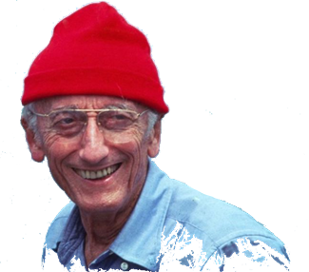
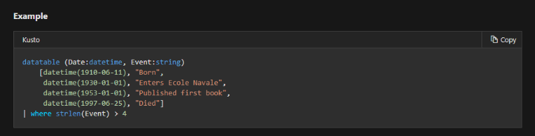
Jacques Cousteau
Actual references to Jacques in the Kusto documentation
https://docs.microsoft.com/en-us/azure/kusto/query/datatableoperator?pivots=azuremonitor
Notes:
Date of birth.
In 1930, he entered the École Navale and graduated as a gunnery officer.
Published his first book: The Silent World: A Story of Undersea Discovery and Adventure (1953)
Date of death.

Slide 9
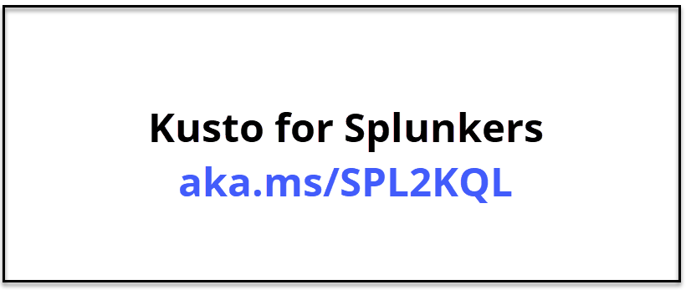
Yes, Related to SQL
SQL to Log Analytics query (KQL) - Structured Query Language
Description | SQL Query | Log Analytics Query
Select all data from a table | SELECT * FROM dependencies | dependencies
Select specific columns from a table | SELECT name, resultCode FROM dependencies | dependencies | project name, resultCode
Select 100 records from a table | SELECT TOP 100 * FROM dependencies | dependencies | take 100
Null evaluation | SELECT * FROM dependencies WHERE resultCode IS NOT NULL | dependencies | where isnotnull(resultCode)
String comparison: equality | SELECT * FROM dependencies WHERE name = "abcde" | dependencies | where name == "abcde"
String comparison: substring | SELECT * FROM dependencies WHERE like "%bcd%" | dependencies | where name contains "bcd"
String comparison: wildcard | SELECT * FROM dependencies WHERE name like "abc%" | dependencies | where name startswith "abc"
Date comparison: last 1 day | SELECT * FROM dependencies WHERE timestamp > getdate()-1 | dependencies | where timestamp > ago(1d)
Date comparison: date range | SELECT * FROM dependencies WHERE timestamp BETWEEN '2016-10-01' AND '2016-11-01' | dependencies | where timestamp between (datetime(2016-10-01) .. datetime(2016-10-01))
Boolean comparison | SELECT * FROM dependencies WHERE !(success) | dependencies | where success == "False"
Sort | SELECT name, timestamp FROM dependencies ORDER BY timestamp asc | dependencies | order by timestamp asc
Distinct | SELECT DISTINCT name, type FROM dependencies | dependencies | summarize by name, type
Grouping, Aggregation | SELECT name, AVG(duration) FROM dependencies GROUP BY name | dependencies | summarize avg(duration) by name
Column aliases, Extend | SELECT operation_Name as Name, AVG(duration) as AvgD FROM dependencies GROUP BY name | dependencies | summarize AvgD=avg(duration) by operation_Name | project Name=operation_Name, AvgD
Notes:
SQL to Azure Monitor log query cheat sheet
https://docs.microsoft.com/en-us/azure/azure-monitor/log-query/sql-cheatsheet

Slide 10
Get to Know the Tool

Slide 11
Queries Overview
Using Log Analytics queries is the way you manipulate at the data in Microsoft Sentinel.
Log Analytics provides the following features for working with log queries:
Multiple tabs – create separate tabs to work with multiple queries
Rich visualizations – variety of charting options
Improved Intellisense and language auto-completion (tab complete)
Syntax highlighting – improves readability of queries
Query explorer – access saved queries and functions
Schema view – review the structure of your data to assist in writing queries
Share – create links to queries, or pin queries to any shared Azure dashboard
Smart Analytics - identifies spikes in your charts and a quick analysis of the cause
Column selection – sort and group columns in the query results
Notes:
Analyze log data in Azure Monitor
https://docs.microsoft.com/en-us/azure/azure-monitor/log-query/log-query-overview

Slide 12
Log Analytics Demo

Slide 13
Get to Know the Tool
Follow along…
aka.ms/LADemo
It’s available to anyone with a Microsoft Account ☺
Notes:
Filtering through the table elements
Sorting results
Grouping results
Selecting columns to display
Select a time range
Save search queries
Share Queries!
Multiple Queries – Gotcha (tip) - Best Practice for Multiple Queries – Tabs
Intellisense/Autocomplete – tip
Charts - SecurityEvent | where isnotempty(EventID) | where TimeGenerated > ago(1d) | summarize count() by Account
Schema (tables – queries – functions)

Slide 14
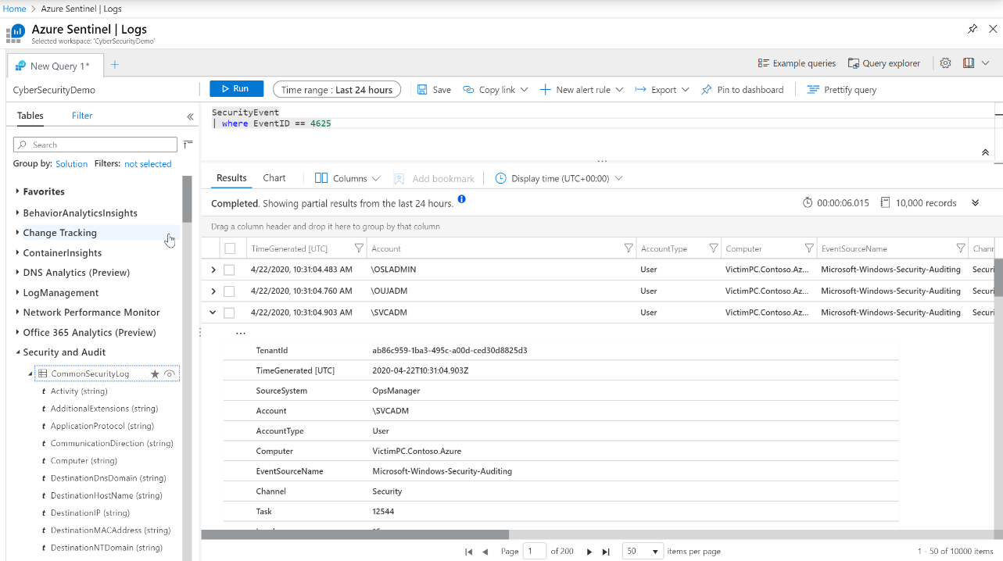
Query Window Overview
Query window
The ribbon
Tables
Column chooser
Results pane
Typed columns
Notes:
Instructor Notes:
Go over the different sections/ features of the Query Window.

Slide 15
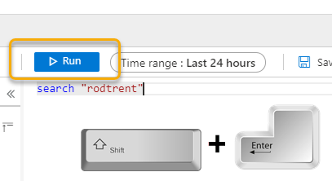
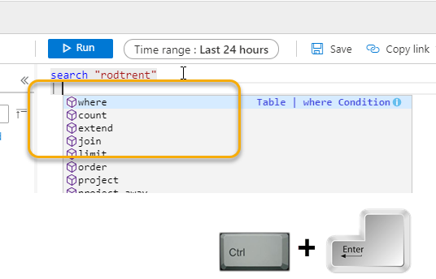
Keyboarding Tip(s)
Shift + Enter = Run the query
Ctrl + Enter = New line/start a command
Notes:
Shift + Enter = Run the query
Ctrl + Enter = New line/start a command

Slide 16
Different Demo Environments
KQL Playground vs. Kusto Free
https://aka.ms/LADemo vs. https://aka.ms/KustoFree
Notes:
Difference is that LADemo is Microsoft data, KustoFree you can use your data that you ingest.

Slide 17
Understanding KQL

Slide 18
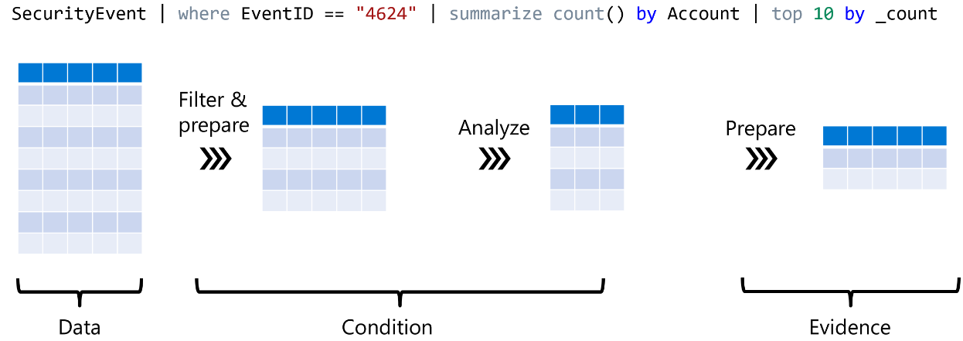
Get started with Log Analytics
Understanding the pipe
Count_
Notes:
Get started with Azure Monitor log analytics
https://docs.microsoft.com/en-us/azure/azure-monitor/log-query/get-started-portal
https://docs.microsoft.com/en-us/sharepoint/dev/general-development/keyword-query-language-kql-syntax-reference

Slide 19
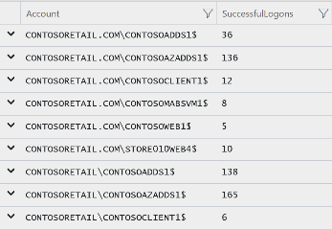
(The Essence) Structure of KQL Queries
Table
What?
Data aggregation
Pipe
Command separation
SecurityEvent
| where TimeGenerated > ago (1h)
| where EventID == 4624
| summarize count() by Account
| order by Account asc
| project Account , SuccessfulLogons = count_
Filter
Where?
Order data

Slide 20
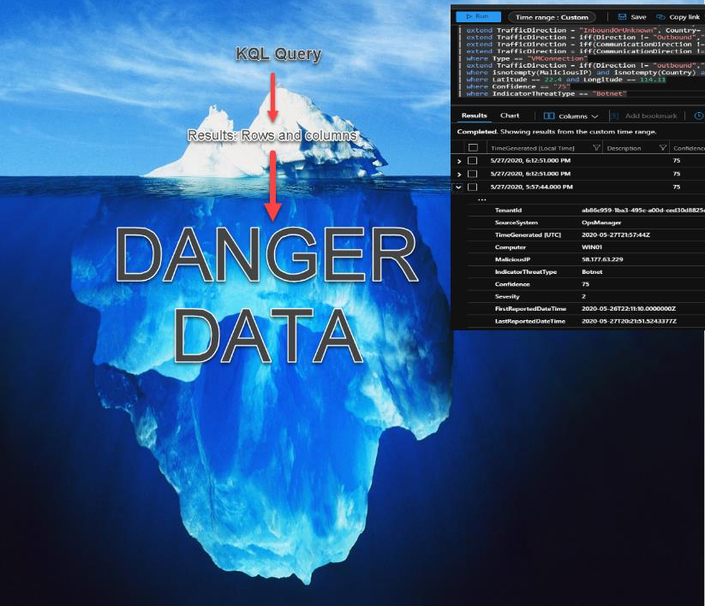

Slide 21
Digging In

Slide 22
KQL Column Types
Basic
int, long
bool: true, false
string: “example”, ‘example’
Time
datetime: datetime(2016-11-20 22:30:15.4), now(), ago(4d)
timespan: 2d, 20m, time(1.13:20:05.10), 100ms
Complex
dynamic: JSON format
Notes:
Integer = The types integer and LONG data type represent numerical types.
Boolean = true, false / logical operators
The dynamic scalar data type is special in that it can take on any value of other scalar data types, as well as arrays and property bags. Specifically, a dynamic value can be:
Null.
A value of any of the primitive scalar data types: boolean, datetime, guid, integer, long, real, string, and timespan.
An array of dynamic values, holding zero or more values with zero-based indexing.
A property bag that maps unique string values to dynamic values. The property bag has zero or more such mappings (called "slots"), indexed by the unique string values. The slots are unordered.
Also a great method to create Functions (for a more advanced source).

Slide 23
‘where’ command
Filters a table to the subset of rows that satisfy a predicate.
Syntax: T | where Predicate
Examples: SecurityEvent | where TimeGenerated > ago(1d)
SecurityEvent | where * contains “Kusto”
String predicates: ==, has, contains, startswith, endswith, matches regex, etc
Numeric/Date predicates: ==, !=, <, >, <=, >=
Empty predicates: isempty(), notempty(), isnull(), notnull()
Notes:
Use simple comparisons between column names and constants. ('Constant' means constant over the table - so now() and ago() are OK, and so are scalar values assigned using a let statement.)
Regex = A regular expression is a pattern that the regular expression engine attempts to match in input text. A pattern consists of one or more character literals, operators, or constructs.
For example, prefer where Timestamp >= ago(1d) to where floor(Timestamp, 1d) == ago(1d).
Simplest terms first: If you have multiple clauses conjoined with and, put the clauses that involve just one column first.
So Timestamp > ago(1d) and OpId == EventId is better than the other way around.

Slide 24
‘where’ exercise
SecurityEvent
| where TimeGenerated > ago(1h)
| where EventID == 4624 // Successful logon
| where AccountType =~ "user" // case insensitive
(https://aka.ms/lademo)
Notes:
Go over the structure of a query!
NOTE the COMMENTing indicator.

Slide 25
‘limit’ / ‘take’ command
Return up to the specified number of rows.
Syntax: T | limit <number>
Example: SecurityEvent | limit 5
Sort is not guaranteed to be preserved.
Consistent result is not guaranteed (when running the same query twice)
Very useful when trying out new queries.
Default limit is 30,000.
Notes:
Random set of records retrieved.
Great for testing new queries, viewing data (data sampling).

Slide 26
‘limit’ / ‘take’ exercise
SecurityEvent
| limit 10
SecurityEvent
| where TimeGenerated > ago(1h)
| where EventID == 4624
| where AccountType =~ "user"
| take 10
(https://aka.ms/lademo)

Slide 27
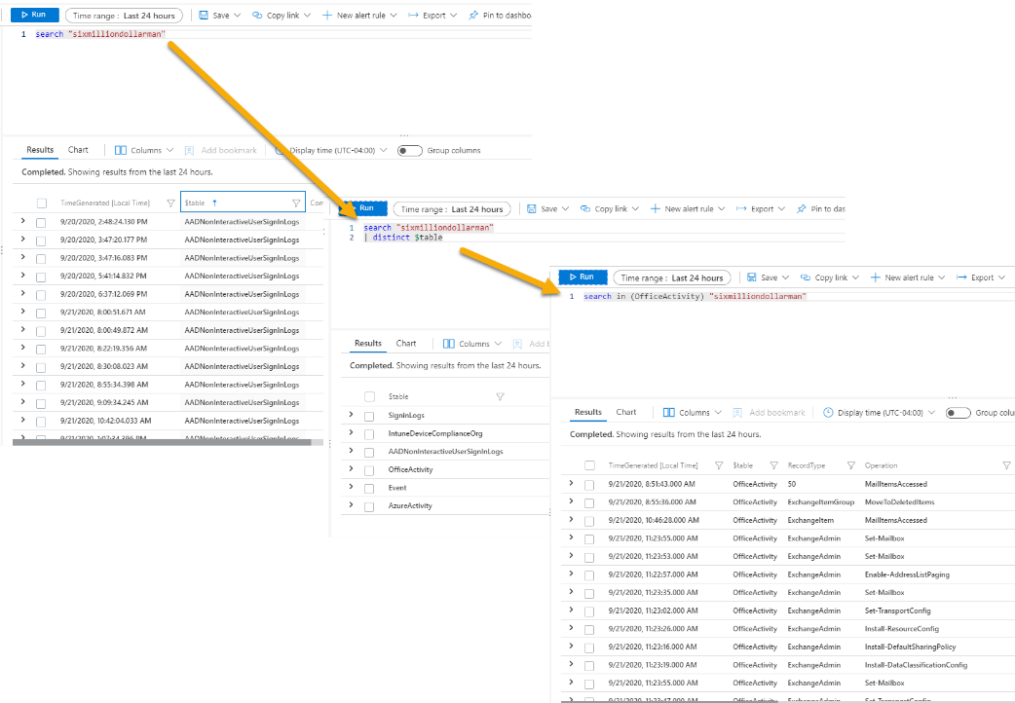
Data Sampling Tip – search string
The search operator provides a multi-table/multi-column search experience.
Does it exist?
Where does it exist?
Why does it exist?

Slide 28
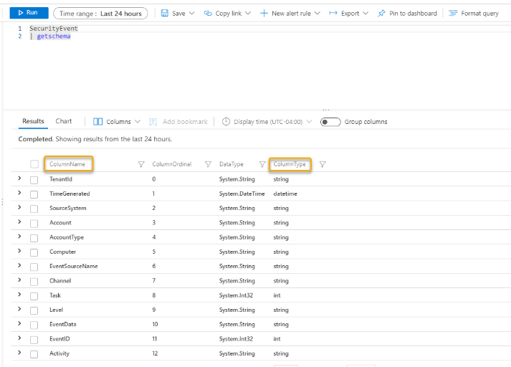
Data Sampling Tip: What’s in the Table?
Syntax: T | getschema
Example: SecurityEvent | getschema

Slide 29
‘count’ command
Returns the number of records in the input record set.
Syntax: T | count
Example: SecurityEvent | count
Notes:
Count = Returns the number of records in the input record set.

Slide 30
‘count’ exercise
SecurityEvent
| where TimeGenerated > ago(1h)
| where EventID == 4624
| count
(https://aka.ms/lademo)

Slide 31
‘summarize’ command
Produces a table that aggregates the content of the input table.
Syntax: T | summarize Aggregation [by Group Expression]
Examples: SecurityEvent | summarize count() by Computer
Simple aggregation functions: count(), sum(), avg(), min(), max(),
Advanced functions (next slide): arg_min(), arg_max(), percentiles(), makelist(), countif()
Notes:
Summarize, uh, summarizes. Produces a table that aggregates the content of the input table.

Slide 32
‘summarize’ exercise
SecurityEvent
| where TimeGenerated > ago(1h)
| where EventID == 4624
| summarize count() by AccountType, Computer
Count logins by user and computer
(https://aka.ms/lademo)

Slide 33
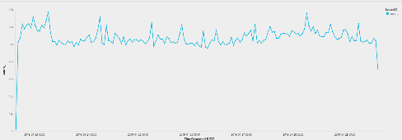
‘summarize’: bin and time series
A very useful summarize operation is creating time series:
SecurityEvent | summarize count() by bin(TimeGenerated, 1h) | render timechart
Other time measurements: 1h, 5d, 10m (defaults to 1h)
Can create multiple legends by aggregating additional field
Notes:
Bin = Rounds values down to an integer multiple of a given bin size. Used frequently in combination with summarize by .... If you have a scattered set of values, they will be grouped into a smaller set of specific values.

Slide 34
Render Operator
Generates a visualization of the query results.
Syntax: T | render Visualization [with ( PropertyName = PropertyValue [, ...] )]
Supported visualizations:
Areachart
Barchart
Columnchart
Piechart
Scatterchart
timechart
Notes:
Instructs the user agent to render the results of the query in a particular way.
The render operator should be the last operator in the query, and used only with queries that produce a single tabular data stream result. (for example, our summarize command)
The render operator does not modify data.
EXTRA:
The interpretation of the visualization information is done by the user agent. Different agents (such as Kusto.Explorer,Kusto.WebExplorer) might support different visualizations.

Slide 35
‘bin’ exercise
SecurityEvent
| where TimeGenerated > ago(7d)
| summarize count() by bin(TimeGenerated, 1d)
| render barchart
(https://aka.ms/lademo)

Slide 36
Lab 1

Slide 37

1st Scenario
Your SOC has just discovered that a hacker has been using brute force attacks against your network for the past 7 days. You need to find the count of failed logins for each user account and computer being attacked during that period.
Hints and guidelines:
Use the SecurityEvent table to begin your search.
How would you find the EventID for failed logins using KQL?
What column would have the account name?
Notes:
Answer Sneak Peek: SecurityEvent
| where TimeGenerated <= ago(7d)
| where EventID == 4625
| summarize count() by TargetAccount, Computer

Slide 38
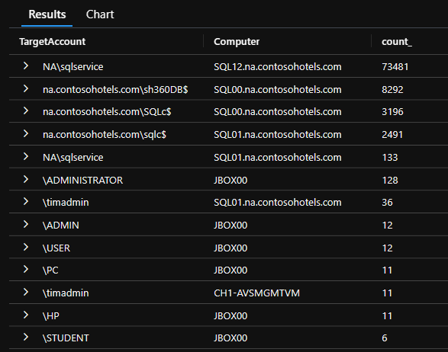
1st Lab Exercise
// Find the count of failed logins by Account Name
// run parts of the query, adding a line at the time, to learn more
SecurityEvent
| where TimeGenerated <= ago(7d)
| where EventID == 4625
| summarize count() by TargetAccount, Computer

Slide 39
Lab 2

Slide 40
2nd Scenario
A hacker has compromised your network and has successfully logged into your network. To find the intruder, you need to find all Windows logon events starting 2 weeks ago until 1 week ago that occurred on a computer with a name which starts with “App” .
Hints and guidelines:
Windows security events are stored in the table “SecurityEvent”
The logon event id is 4624. What is the name of the field which contains the event ID?
What is the name of the field which represents the computer name?
What should be the order of the commands for better performance?
Bonus: Can you find the count per computer as well?
Notes:
SecurityEvent
| where TimeGenerated between (ago(14d)..ago(7d))
| where EventID == "4624"
| where Computer startswith "App"
| summarize count() by Computer

Slide 41
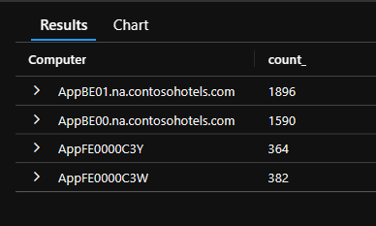
2nd Lab Exercise
// Find all Windows logon events starting 2 weeks ago until 1 week ago that occurred on a computer with name which starts with “App”
SecurityEvent | limit 100 // Find relevant fields: Activity, EventID, Computer
SecurityEvent | summarize by Activity // find the Event signaling login
SecurityEvent
| where TimeGenerated between (ago(14d)..ago(7d)) // start with the time filter
| where EventID == "4624"
| where Computer startswith "App" // case insensitive
// This is the solution, but there are so many results
SecurityEvent
| where TimeGenerated between (ago(14d)..ago(7d))
| where EventID == "4624"
| where Computer startswith "App"
| summarize count() by Computer
// so let’s count per computer

Slide 42
Lab 3

Slide 43

3rd Scenario
An APT has installed malware on your network . In order to find the traces of malware, you need to find out how many times each process ran per computer.
Hints and guidelines:
Event 4688 logs process creation.
Which column represents the processes created?
Which computer was it ran on?
Notes:
SecurityEvent
| where EventID == "4688"
| summarize count() by Process, Computer

Slide 44
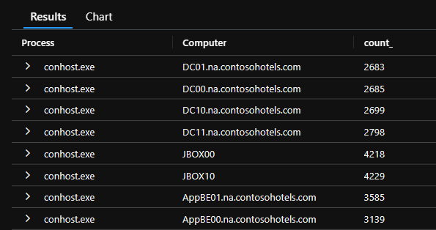
3rd Lab Exercise
// Find how many times each process ran per computer
SecurityEvent | summarize by Activity // Let’s find the event that includes process names
SecurityEvent | where EventID == "4688" | limit 10
// find the relevant field, in this case "Process"
SecurityEvent
| where EventID == "4688"
| summarize count() by Process, Computer

Slide 45
Lab 4

Slide 46

4th Scenario
Your SOC has just discovered a Crypto-Mining Agent has been installed on one of your domain controllers. You need to chart the rate of process creation on all domain controllers in order to discover which DC has been compromised .
Hints and guidelines:
Process creation is Windows event 4688
All Domain controller names start with “DC”
This will be a time chart. (Think bin...)
Notes:
// Chart the rate of process creation on all domain controllers.
SecurityEvent
| where Computer startswith "DC"
| where EventID == "4688" | summarize count() by Computer, bin(TimeGenerated, 1h)
| render timechart

Slide 47
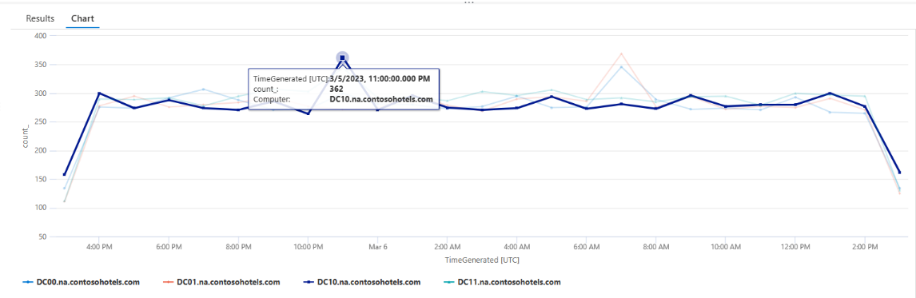
4th Lab Exercise
// Chart the rate of process creation on all domain controllers.
SecurityEvent
| where Computer startswith "DC"
| where EventID == "4688" | summarize count() by Computer, bin(TimeGenerated, 1h)
| render timechart

Slide 48
‘extend’ command
Create calculated columns and append them to the result set.
Syntax: T | extend ColumnName [= Expression] [, ...]
Example: SecurityEvent | extend ComputerNameLength = strlen(Computer)
The new added column is not indexed.
To only change a column name, use ‘project-rename’.
Useful function for in ‘extend’: iff, extract
Notes:
Create calculated columns of data.
Example creates a new column called ComputerNameLength of the calculation of the number of characters of the computer name in the Computer column.
Also a way to create custom Entities.

Slide 49
‘project’ command
Select the columns to include, rename or drop, and insert new computed columns.
Syntax: T | project ColumnName [= Expression] [, ...]
Example: SecurityEvent | project TimeGenerated, Computer
‘| project-away’ – Removed specified column/s.
‘| project-rename’ – Rename specified column/s.
Notes:
Displaying columns that you want to display.
Project Away = show all columns BUT…

Slide 50
‘extend’ & ‘project’ exercise
Perf
| where CounterName == "Free Megabytes"
| extend FreeKB = CounterValue * 1024
| extend FreeGB = CounterValue / 1024
| extend FreeMB = CounterValue
| project Computer, CounterName, FreeGB, FreeMB, FreeKB
(https://aka.ms/lademo)
Notes:
Example 1: Taking CounterValue calculation and producing FreeKB and FreeGB columns.

Slide 51
‘distinct’ command
Produces a table with the distinct combination of the provided columns of the input table.
Syntax: T | distinct Column1, Column2
Example: SecurityEvent | distinct Computer
Notes:
Distinct = Produces a table with the distinct combination of the provided columns of the input table. Matches up data from multiple columns and displays them together.

Slide 52
‘distinct’ exercise
Perf
| distinct Computer
Perf
| distinct ObjectName
Perf
| distinct ObjectName, CounterName
(https://aka.ms/lademo)
Notes:
Example 1: We can find all the computers that are reporting performance data to Log Analytics.
Example 2: Using the same performance example, finding all the object types that we have performance data for.
Example 3: We want to see all the metrics for each object, in this case CounterName.
Example 4: We can get our Windows Update Settings for all servers we’re managing with the Update Management solution.
Example 5: However, we’re not limited to just one or two fields. We can add more, in this example we’ll get our servers, their update setting, OS version and the oldest update they need in days.
Example 6: Finally, we can quickly build a report of servers needing updates, the KB number and title of the update.

Slide 53
‘order by’ / ‘sort by’ & ‘top’ operator
Order by: Sort the rows of the input table into order by one or more columns.
Top: returns the top values after sort. Faster and can sort by expression
Syntax: T | sort by column [asc | desc] [nulls first | nulls last]
T | top NumberOfRows by Expression [asc | desc] [nulls first | nulls last]
Example: SecurityEvent | order by Account asc, Computer desc
Don’t assume order by default
Notes:
Order by: Sort the rows of the input table into order by one or more columns.
Top: returns the top values after sort. Faster and can sort by expression

Slide 54
‘order by’ / ‘top’ exercise
SecurityEvent
| where TimeGenerated > ago(7d)
| order by TimeGenerated desc
| limit 100
SecurityEvent
| top 100 by TimeGenerated desc
(https://aka.ms/lademo)

Slide 55
‘let’ statement
Let statements bind names to expressions.
declare global ‘variable’ or reuse of ‘variables’.
Reuse of query runs
Declare functions
Declare dynamic table
Notes:
Let = creating “variables” for use later in the script. Best practice, for developing better performing queries and query code re-use.
Creates variables.
Let statements bind names to expressions. For the rest of the scope in which the let statement appears (global scope or in a function body scope), the name can be used to refer to its bound value. If that name was previously bound to another value, the "innermost" let statement binding is used.

Slide 56
‘let’ exercise
let timeOffset = 7d;
let discardEventId = 4688;
SecurityEvent
| where TimeGenerated > ago(timeOffset*2) and TimeGenerated < ago(timeOffset)
| where EventID != discardEventId

Slide 57
‘union’ operator
Takes two or more tables and returns the rows of all of them.
Example:
SecurityEvent| union (SecurityAlert | where AlertSeverity == "high")
kind=inner(common columns), outer (all columns- default)
Supports wildcard to union multiple tables (union Security*)
Can union between tables from different clusters (or workspaces)
Notes:
Returns ALL rows side-by-side.
Merges two tables by a common column and displays the results.

Slide 58
‘union’ exercise
SecurityEvent
| union Heartbeat
| summarize count() by Computer
(https://aka.ms/lademo)
Notes:
Query SecurityEvent, merges with the Heartbeat column and shows the count by Computer for both tables.

Slide 59
Lab 4

Slide 60

4th Scenario
Your Azure Environment has suffered an attack with multiple brute force attacks. No compromise took place; however, you need to know what user account was used and what country the attacker attempted to log in from. The results should only show the timestamp, Status, Username and the app name.
Hints and guideline:
This will involve more than one table.
The company did have MFA enabled.
Limit your search to the past 60 days.

Slide 61
4th Lab Exercise
//You need to know what user account was used to sign in and what country they signed in from in the past 60 days.
union SigninLogs, AADNonInteractiveUserSignInLogs
| where TimeGenerated >= ago(60d)
| where Status_dynamic contains "User did not pass the MFA challenge."
| where AppDisplayName contains "Azure Portal“ | project TimeGenerated, Status_dynamic, AppDisplayName

Slide 62
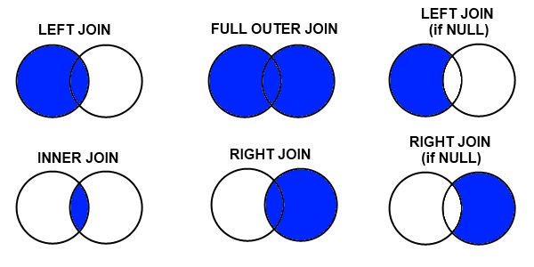
‘join’ operator
Merge the rows of two tables to form a new table by matching values of the specified column(s) from each table.
Syntax: LeftTable | join [JoinParameters] ( RightTable ) on Attributes
Example: SecurityEvent| join (SecurityAlert | where AlertSeverity == "high") on Status
Table1 | join (Table2) on CommonColumn, $left.Col1 == $right.Col2
Notes:
Merge the rows of two tables to form a new table by matching values of the specified column(s) from each table.
Table1 | join (Table2) on CommonColumn, $left.Col1 == $right.Col2

Slide 63
‘join’ exercise
SecurityEvent
| join Heartbeat on Computer
| where EventID == "4688"
| project Computer, OSType, OSMajorVersion, Version
Notes:
Join Heartbeat table with SecurityEvent table on the common Computer column. Provide a filter by EventID and then display only the projected fields.

Slide 64
Lab 5

Slide 65

5th Scenario
A hacker has run an encoded PowerShell command on your network and has started exfiltrating data. You need to find the encoded PowerShell command that was ran on a computer that endswith CSK that was ran in the past 90 days.
Hints and Guidelines:
Use the VMProcess table for your hunt.
There should only be one result.
Notes:
* Results may change VMProcess | where TimeGenerated >= ago(90d)
| where Computer endswith “8RA”
| where CommandLine contains “encoded”

Slide 66
5th Lab Exercise
// Find the encoded PowerShell command that was ran on a computer that endswith 3EX for the past 60 days.
VMProcess | where TimeGenerated >= ago(90d)
| where Computer endswith “CSK”
| where CommandLine contains “encoded”

Slide 67
Lab 6

Slide 68

6th Scenario
As a part of your post incident response, you need to compare the successful and failed logons to determine what day the password spray took place.
You will need to render a graph of successful vs failed logons over the last 30 days, use alias for the legend (“Success”, “Failed”) to find your answer.
Hints and guideline:
Utilize Countif for each EventID
Remember this is a time chart.
Notes:
SecurityEvent
| where TimeGenerated > ago(30d)
| summarize
Success=countif(EventID == 4624),
Failed=countif(EventID == 4625)
by bin(TimeGenerated, 1h)
| render timechart

Slide 69
6th Lab Exercise
// Render graph of successful vs failed logons over the last 30 days, use alias for the legend (“Success”, “Failed”)
// run parts of the query, adding a line at the time, to learn more
SecurityEvent
| where TimeGenerated > ago(30d)
| summarize
Success=countif(EventID == 4624),
Failed=countif(EventID == 4625)
by bin(TimeGenerated, 1h)
| render timechart

Slide 70
Lab 7

Slide 71

7th Scenario
Your company has hired a Pentester to audit your security environment, the results of the test determined that missing patches have resulted in a successful attack against your systems.
You need to find the missing critical security updates for the VM that starts with CH1.
Hints and guideline:
Use the Update table to begin your hunt.
How would you find patch information?
Notes:
Update
| where Classification == "Security Updates" and UpdateState == "Needed" and MSRCSeverity == "Critical"
| where Resource startswith "CH1"

Slide 72
7th Lab Exercise
//Find the missing critical security updates for the VM that starts with CH1.
Update
| where Classification == "Security Updates" and UpdateState == "Needed" and MSRCSeverity == "Critical"
| where Resource startswith "CH1"

Slide 73
Lab 8

Slide 74

8th Scenario
Your Azure Environment has successfully defended an attack from an outside entity. As a part of your IR Report, you need to find the top 3 source IP addresses which were blocked by your firewall.
Hints and guideline:
Which table would you use?
What way does the data “flow” ?
Notes:
union SigninLogs, AADNonInteractiveUserSignInLogs
| where TimeGenerated >= ago(60d)
| where Status_dynamic contains "User did not pass the MFA challenge."
| where AppDisplayName contains "Azure Portal“ | project TimeGenerated, Status_dynamic, AppDisplayName

Slide 75
8th Lab Exercise
// Find the top 3 source IP addresses which were blocked by your firewall.
AzureNetworkAnalytics_CL
| where FlowStatus_s == "D"
| where FlowDirection_s == "I"
| where isnotempty(SrcIP_s)
| summarize count() by SrcIP_s

Slide 76
Lab 9

Slide 77
Lab 9
Use (https://aka.ms/LAdemo) and https://aka.ms/KQLDocs
Find how many times each process ran per computer (hint: look for event ID that represent new process creation)
Render a time chart of free MB over last 7 days for disk C: (hint: InstanceName should be ‘C:’, CounterName should be ‘Free Megabytes’)

Slide 78
Lab 9 solution
//Question 1
SecurityEvent
| where EventID == 4688
| summarize count() by NewProcessName, Computer
//Question 2
Perf
| where InstanceName == "C:"
| where CounterName == "Free Megabytes"
| summarize FreeMB = avg(CounterValue) by bin(TimeGenerated, 1h) | render timechart
Notes:
Quiz 4688: New process created.

Slide 79
Lab 10

Slide 80
Lab 10
Use (https://aka.ms/LAdemo) and https://aka.ms/KQLDocs
The table “SecurityEvent” contains security events collected from Windows machines. The events are identified by their IDs. Find the column that represents this ID, and complete the following tasks:
Render graph of logon events over time, starting from two weeks ago until one week ago.
Render graph of successful (4624) vs failed (4625) logons over the last 7 days, use alias for the legend (“Success”, “Failed”)
Find the last logon time for a user named “ContosoASCAlert\\LBecker”

Slide 81
Lab 10 solution
//Question #A: Render graph of logon events over time, starting from two weeks ago until one week ago.
SecurityEvent
| where EventID == 4624
| summarize count() by bin(TimeGenerated, 1h)
| render timechart
//Question #B: Render graph of successful (4624) vs failed (4625) logons over the last 7 days, use alias for the legend (“Success”, “Failed”)
SecurityEvent
| summarize Success=countif(EventID == 4624), Failed=countif(EventID==4625) by bin(TimeGenerated, 1h)
| render timechart
//Question #C: Find the last logon time for a user named “ContosoASCAlert\\LBecker”
SecurityEvent
| where EventID == 4624
| where Account == "ContosoASCAlert\\LBecker"
| summarize max(TimeGenerated)

Slide 82
Your Turn – Mini Quizzes

Slide 83
Remember
Ultimate goal:
READ KQL QUERIES
Notes:
We’ll use hands-on to write KQL queries, but as a tool for learning the structure and ultimately understanding how KQL queries work. The importance of this course is to learn how to READ the queries. i.e., to understand, line-by-line what each query will do and what the results of running the query will be. Being able to understand what results the query will return is most important for level 100-200 knowledge.

Slide 84
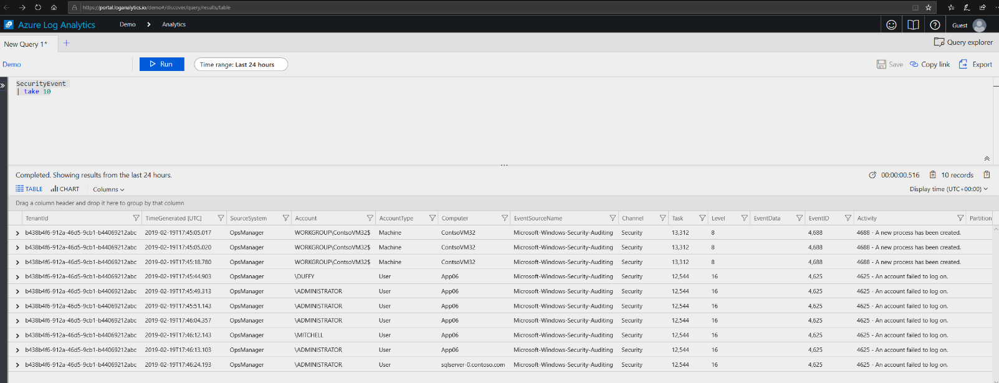
Quiz Time
Example: This query will return 10 results from the SecurityEvent table, in no specific order.
Notes:
Quiz slide

Slide 85
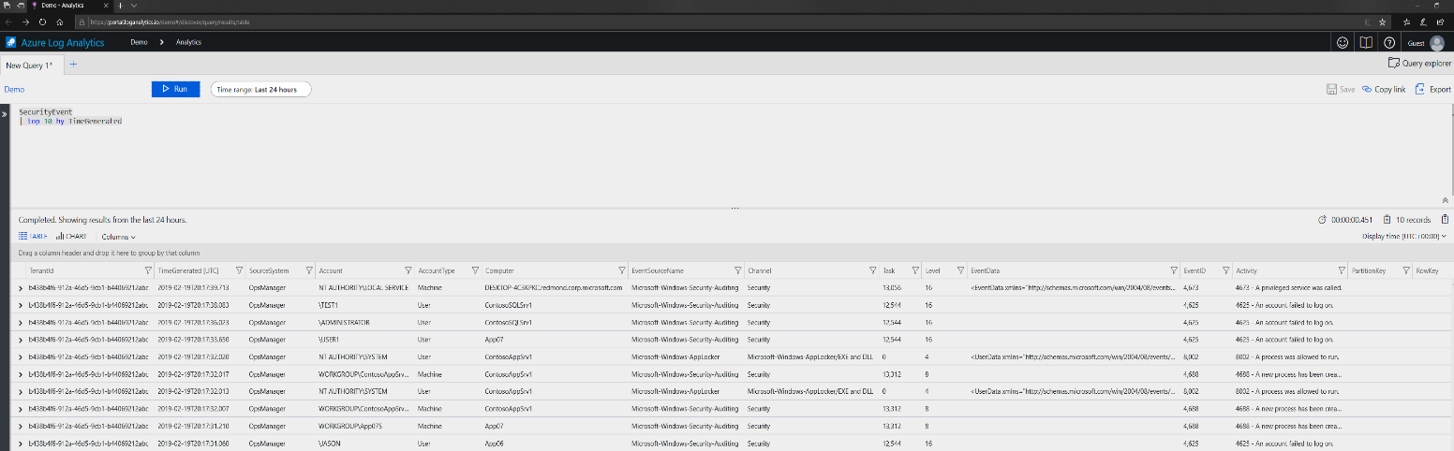
Quiz Time
Sort and top
Example: The best way to get only the latest 10 records is to use top, which sorts the entire SecurityEvent table and then returns the top records.
Notes:
Quiz slide

Slide 86
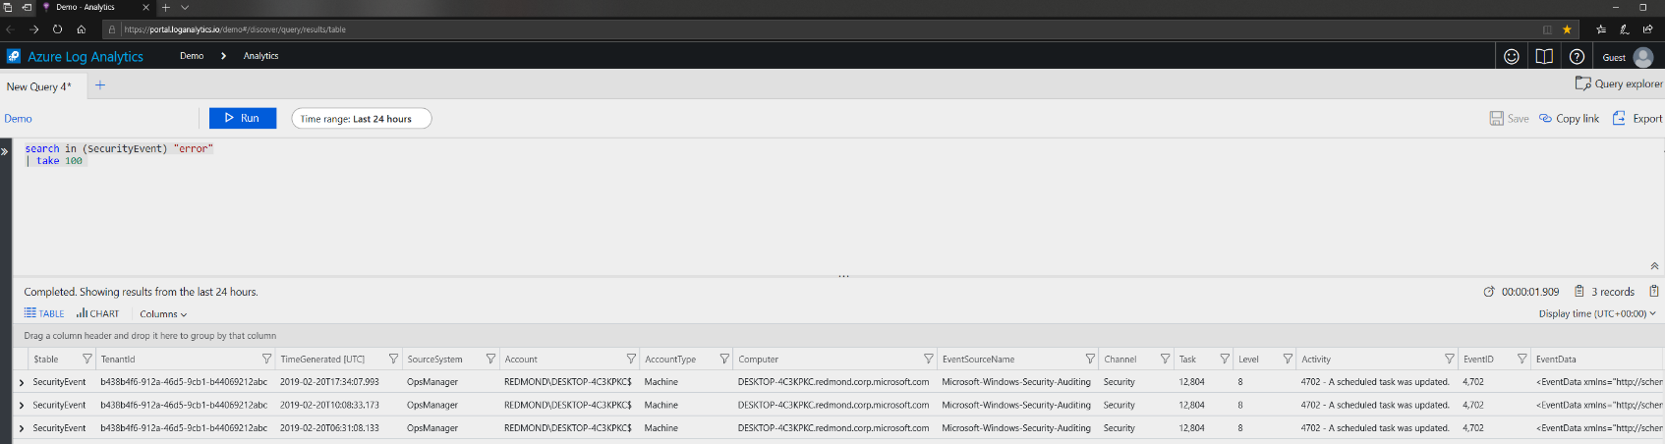
Quiz Time
Search query
Example: This query searches the SecurityEvent table and scans for the term "error” in the events.
Notes:
Quiz slide

Slide 87
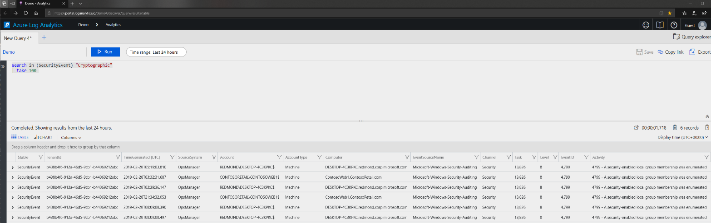
Quiz Time
Search query
Example: This query searches the SecurityEvent table for records that contain the phrase "Cryptographic". Of those records, 100 records will be returned and displayed.
Notes:
Quiz slide

Slide 88
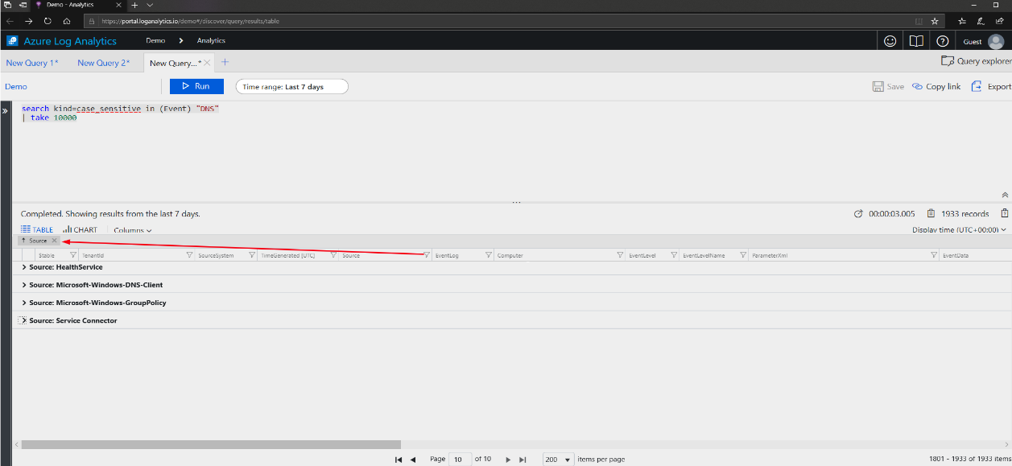
Quiz Time
Search query
Example: This query will search all columns in the table Event for events that contains the phrase “DNS”.
Notes:
Quiz slide

Slide 89
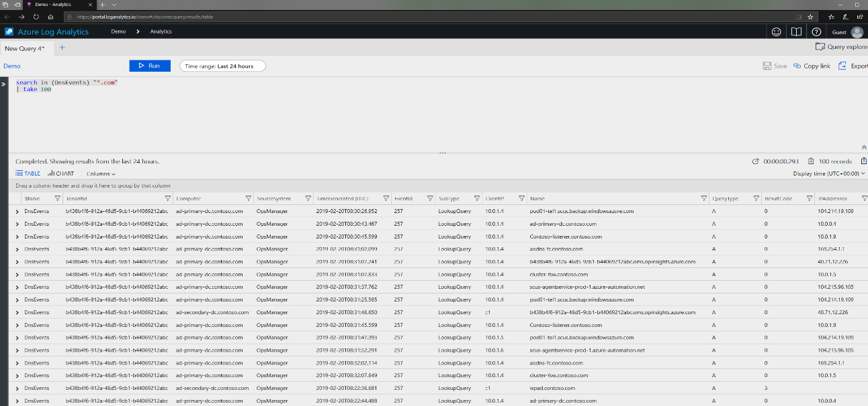
Quiz Time
Search query
Example: This query will search the DNSEvents table for records that contain .com.
Notes:
Quiz slide

Slide 90
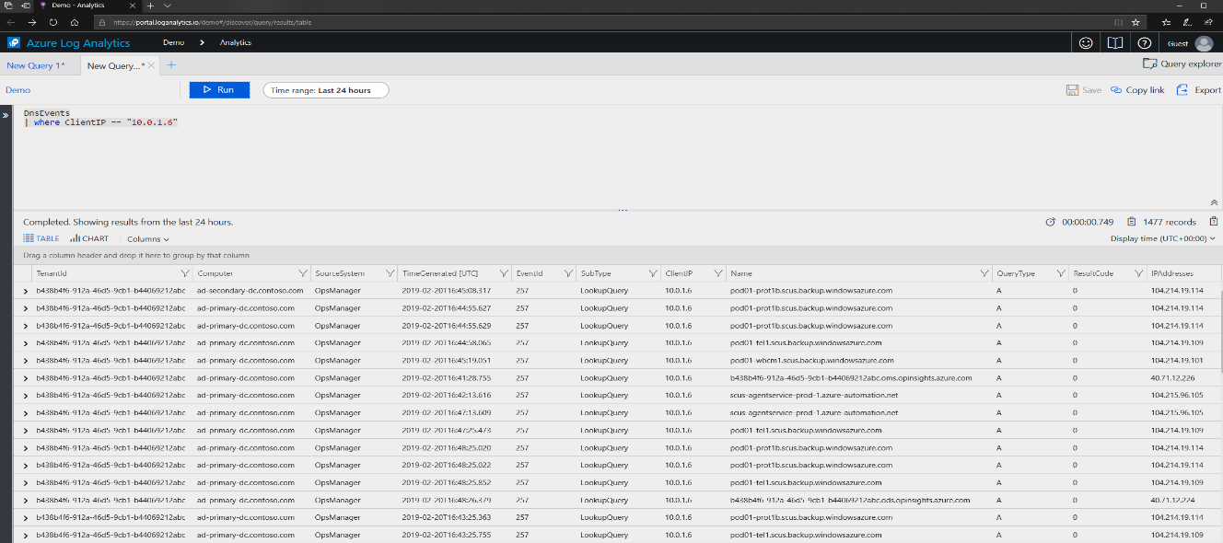
Quiz Time
Writing a new query
Example: This query searches the DnsEvent table for records of a specific ClientIP.
Notes:
Quiz slide

Slide 91
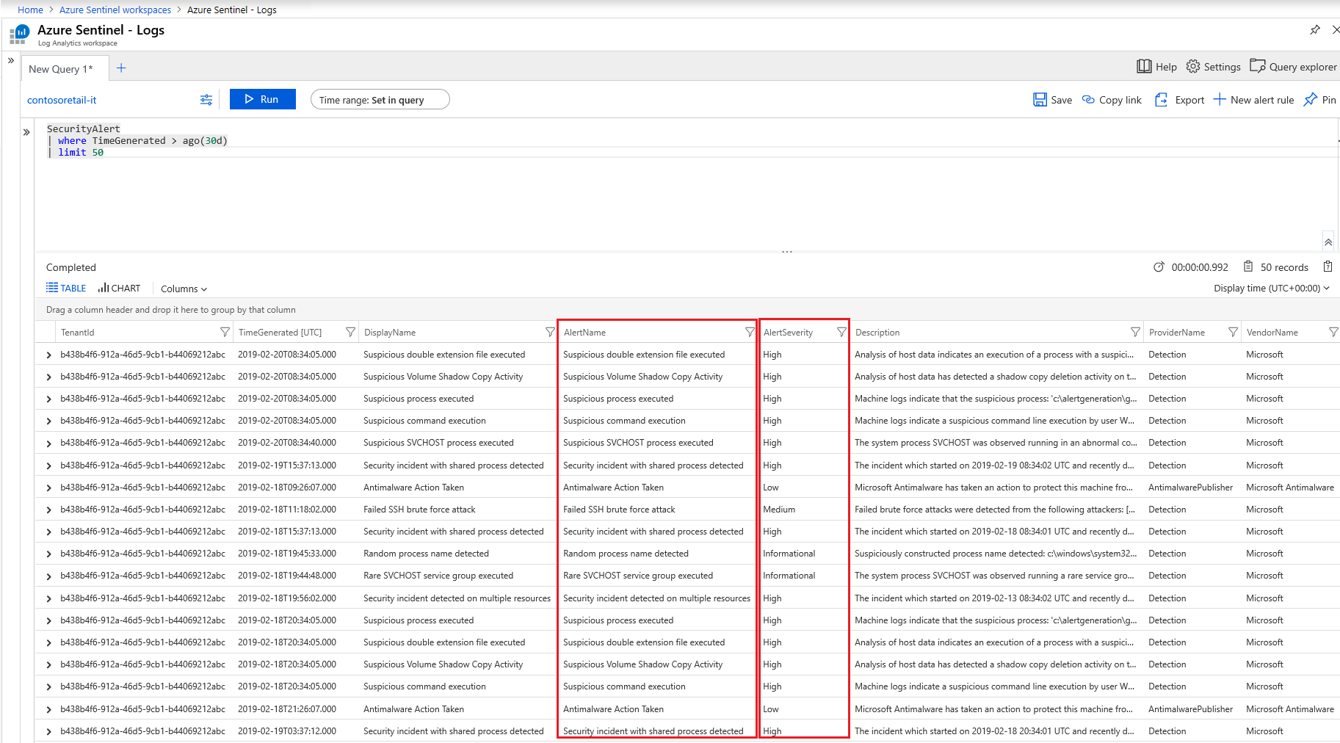
Quiz Time
Security Alert query
Example: This query will search the SecurityAlerts table for events that occurred 30 days ago and limit it to 50 events
Notes:
In this example, SecurityAlerts table is populated with ASC alerts.

Slide 92
Next Steps

Slide 93
Where to go from here?
KQL documentation (aka.ms/KQLDocs)
Azure Monitor Reference (aka.ms/AZMonitorRef)
Open to use KQL playground (aka.ms/LADemo)
Data Explorer (aka.ms/KQLDataExplorer)
Kusto Free (aka.ms/KustoFree)
Kusto.Explorer tool (aka.ms/KustoTool)
Kusto.Cli (aka.ms/KustoCMD)
Visual Studio Code (https://code.visualstudio.com/)
KQL Add-on (aka.ms/KQLPack)

Slide 94
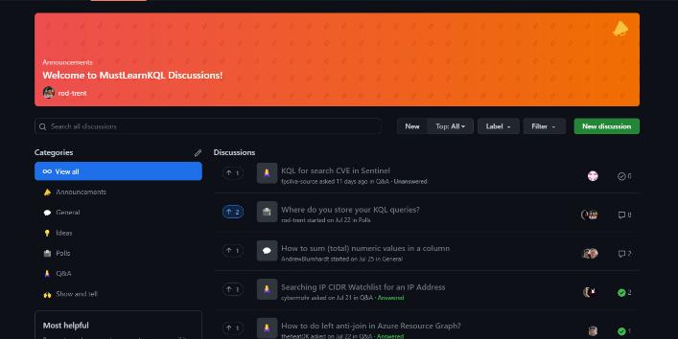
Keep it fresh/Get Help
Kusto Discussions: https://aka.ms/KQLForum
Sentinel Forums: http://aka.ms/SentinelForums
Notes:
For Public

Slide 95
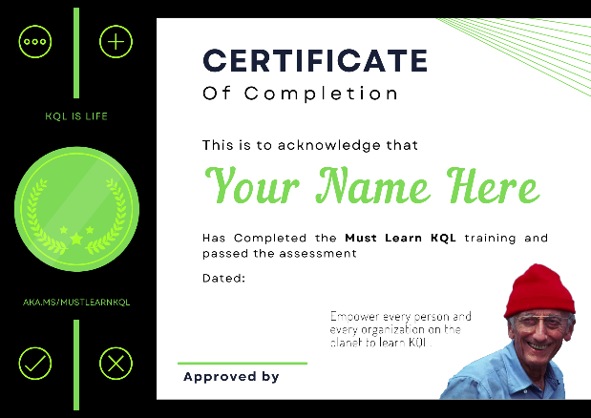
Must Learn KQL Assessment
The assessment is 25 questions taken directly from the Must Learn KQL (https://aka.ms/MustLearnKQL) content. So, you can take advantage of the open book test, or challenge yourself by attempting to pass without help. Based on the honor system, you can miss 5 questions (80%). Once completed, send an email request to:
MustLearnKQL@sixmilliondollarman.onmicrosoft.com
and request your certificate.
https://aka.ms/PassMustLearnKQL
Notes:
After this workshop, customers can go to this link for the assessment.
If they pass, then can request a certificate.

Slide 96

Must Learn KQL (https://aka.ms/MustLearnKQL)
Notes:
If you still need help passing the assessment after this workshop, run through the 20-chapter Must Learn KQL series.

Slide 97

Book versions
The eBook (PDF) is updated whenever changes are made or new parts of the series are released. Get the free eBook: https://github.com/rod-trent/MustLearnKQL/tree/main/Book_Version Want a paperback or hardcover version of the book? You can order a copy from Amazon.com: https://amzn.to/39maJSX *
KindleUnlimited subscribers can read for free.
* All proceeds go to St. Jude.

Slide 98
THANK YOU!

